Slide 1
JVM Garbage First
Li Hanhui
Notes:
duration and distribution of stop-the-world pauses due to garbage collection predictable and configurable

Slide 2
G1 Garbage Collector
Regionalized and Generational
Young Collection and Mixed Collection
Collection Sets (CSets) - live objects
Remembered Sets (RSets)
the CMS can only collect the old generation concurrently, it still needs to halt the application to collect the young generation
Notes:
only a subset of the regions, called the collection set will be considered at a time.
All the Young regions are collected during each pause, but some Old regions may be included as well

Slide 3

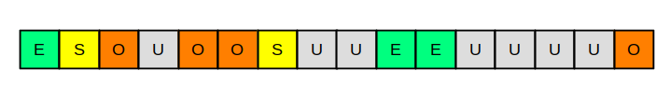
G1 Heap Region
(O: old, S: survivor, E: Eden, U: unassigned)

Slide 4
G1 Heap Region
Region Type
Free Heap Region；eden; survivor；Starts Humongous; Continues Humongous; Old; Open Archive; Close Archive
Region Size
1M -> 2M -> 4M -> 8M -> 16M -> 32M
Region Number
2048 as default

Slide 5
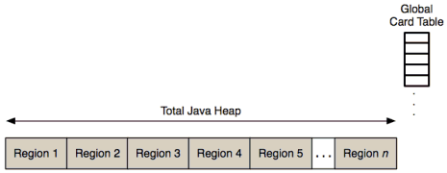
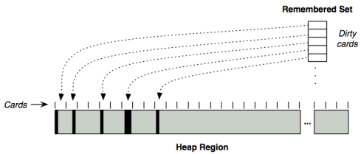
G1 Heap Region

Slide 6
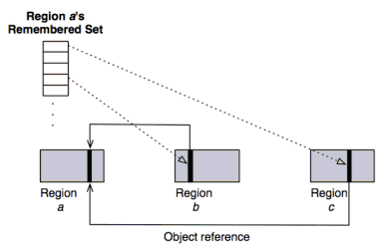
G1 Heap Region
Dirty cards: three levels of courseness with sparse, fine, and course.

Slide 7
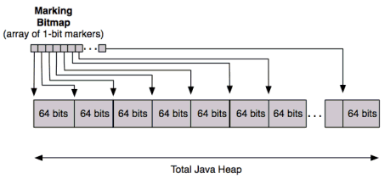
Concurrent Marking

Slide 8
Young GC
Non-contiguous regions
Stop the world
Done in parallel using multple threads
Live objects are copied to new survivor or old generation regions.
Notes:
When the Young Generation fills up, the application threads are stopped, and the live data inside the Young regions is copied to Survivor regions, or any free regions that thereby become Survivor.
The process of copying these is called Evacuation, and it works in pretty much the same way as the other Young collectors we have seen before.

Slide 9
Phases of the Marking Cycle
Initial marking phase - STW
Root region scanning phase - not STW
Concurrent marking phase - not STW
Remark phase - STW, and help the completion of the marking
Cleanup phase - STW

Slide 10
Mixed(Old) GC
Stop the world

Slide 11
G1 Full GC
When the concurrent collections can't reclaim memory fast enough - Evacuation Failure (no free region to evacuate)
to parallelize the mark-sweep-compact algorithm and use the same number of threads

Slide 12
Thread Local Allocation Buffer
Allocate inside TLAB
Allocate inside TLAB with slow path
Allocate outside TLAB

Slide 13
Remembered Set(RSet)
PointIn(G1) and PointOut
Heap Region: the smallest piece of a G1CollectedHeap
HeapRegionRemSet
OtherRegionsTable
PerRegionTable
Heap Region > HeapRegionRemSet > OtherRegionsTable

Slide 14
Remembered Set(RSet)
PointIn(G1) and PointOut
Heap Region: the smallest piece of a G1CollectedHeap
Breaking down regions into 512 Byte segments called cards
HeapRegionRemSet
OtherRegionsTable
PerRegionTable
Heap Region > HeapRegionRemSet > OtherRegionsTable
Write barrier is used to update the remembered set

Slide 15
Dirty Card Queue Set
To support async operation on RSet
G1BarrierSet: DirtyCardQueueSet and G1SATBMarkQueueSet
ConcurrentGCThread
G1ConcurrentRefineThread
G1RootProcessor

Slide 16
Tuning the G1 Collector
-XX:MaxGCPauseMillis=50 (for a target of 50 milliseconds)
-XX:GCPauseIntervalMillis=1000 (for a target of 1000 milliseconds)
-XX:+G1YoungGenSize=512m (for a 512 megabyte young generation)
-XX:+G1ParallelRSetUpdatingEnabled
-XX:+G1ParallelRSetScanningEnabled

Slide 17
Reference
https://docs.oracle.com/javase/8/docs/technotes/guides/vm/gctuning/g1_gc_tuning.html
https://www.dynatrace.com/news/blog/understanding-g1-garbage-collector-java-9/
https://www.infoq.com/articles/G1-One-Garbage-Collector-To-Rule-Them-All/
https://www.oracle.com/webfolder/technetwork/tutorials/obe/java/G1GettingStarted/index.html
http://openjdk.java.net/jeps/307
https://www.drdobbs.com/jvm/g1-javas-garbage-first-garbage-collector/219401061?pgno=2
https://plumbr.io/handbook/garbage-collection-algorithms-implementations/g1 (exclent)
http://www.insightfullogic.com/2013/Jun/24/garbage-collection-java-4/
http://citeseerx.ist.psu.edu/viewdoc/download?doi=10.1.1.63.6386&rep=rep1&type=pdf
https://stackoverflow.com/questions/57303600/how-and-where-does-allocating-a-heap-memory-interpreted-inside-openjdk-source-co (some explaination)
https://hellokangning.github.io/en/post/jvm-series-oop-klass/

